Slide 1
2018/2019 BHS Band Booster Association Kick-off Meeting August 14th, 2018

Slide 2
The Buckhorn High School Band Booster Association
The Buckhorn High School Band Booster Association is a non-profit organization comprised of the parents of the Buckhorn High School Band’s student members. The band program receives NO state funding and therefore relies COMPLETELY upon the Association’s support. Its purpose is to provide personal and financial support to the Buckhorn High School Band program through volunteerism and fundraising efforts so it is able to obtain all that is essential to the success of this award-winning program.

Slide 3
Your Band Booster Association
Membership - As a parent or legal guardian of a band member you are part of the association. Monthly fees are required to maintain membership and keep the program running for our students.
Meeting Schedule - As members it’s important to attend the monthly meetings in August, September, October, February, March and April at a date and time scheduled by the Executive Board.

Slide 4
BHS Band Booster Board
President | Gordon King | BuckBand.Pres@gmail.com
First Vice-President Uniforms/Chaperones/Events | Sarah Posey | BuckBand.1VP@gmail.com
Second Vice-President Concessions/Stadium Clean Up | David Donnelly | BuckBand.2VP@gmail.com
Assistant Second Vice-President Concessions/Stadium Clean Up | Carla Jungen & Sharron Cleere | BuckBand.2VPAsst@gmail.com
Third Vice-President Fundraising | Melanie Jackson | BuckBand.3VP@gmail.com
Treasurer Finances | Mary Miller | BuckBand.Treas@gmail.com
Assistant Treasurer Finances | Lorraine Miller | BuckBand.TreasAsst@gmail.com
Secretary Charms/Docs/Social/Web | LaVeta Solanto | BuckBand.Sec@gmail.com

Slide 5
August Meeting Business
18/19 Operational Budget: Available for reference in CHARMS under Files & Handouts Tab
Approved in June by new Board
Includes:
repurpose of uniform fund contribution to new truck
paid off trailer loan 1 year early
No fee increases …however
Need fees paid on time!
Substantial GF fundraising required for the new truck
Reductions in several areas

Slide 6
Equipment Crew
Need several more volunteers
Free access to games & competitions
No charms sign ups, contact Gordon
Flexible Friday schedule for early loading ideal
Competition days start early, end late … but worth it!

Slide 7
Competitions
Sep 22nd - Stone River Championship
Siegel HS, Murfreesboro TN
Oct 6th - Trussville Marching Invitational
Hewitt-Trussville HS, Trussville AL
Oct 20th - Contest of Champions
Jacksonville State University, Jacksonville AL

Slide 8
1st VICE-PRESIDENT
Committee Chairs - Events: Melissa Hershbine
- Uniforms: Sara Sparks
- Chaperones: Tammy Germany
Chaperone volunteering - using charms to sign up

Slide 9
2nd VICE-PRESIDENT
Concessions volunteering - using charms to sign up
Keeping it fair
Clean-up
Parking and arrival times - important to be on time!
Help for bag lunches and dinners
Parents/Students Working Concessions Stand:
Varsity Games: $50
Varsity Clean Up: $25 (stadium morning after home game)
JV/Freshman: $50 (includes cleaning stadium after game)

Slide 10
3rd VICE-PRESIDENT
Committee Chair - Melissa Hershbine
BHS Apparel Sale: Going on now and ends 8/22/18
Cherrydale Cookie Dough Fundraiser: 10/16-10/30
Students will receive 40% profit if 350 units sold
Special donation events

Slide 11
Student Fundraisers cont.
EAA Breakfast: Coordinator Jessica Donnelly
3rd Saturday of each month
September (breakfast and lunch)
Funds will be divided equally among the number of students and distributed into student’s accounts once a quarter.
Mid February 2019: Cherrydale Candy Bars
Sell for $1 receive 50% profit. Must “purchase” 60 bar box upfront. Cannot return opened boxes due to health code.
April 2019
Mattress Fundraiser

Slide 12
General Band Fundraisers
El Monte Donation Night: First Monday of every month
Publix: When BHS Band account has $37,500 ‘scanned’ into it’s account, Publix will write BHS Band a check for $250-instructions to register on flyer.
Outdoor Movie Night: Saturday September 29 Movie & Time TBA **Kudos to Gayla Suddarth for organizing **
Silent Auction at Spring Banquet
Spring Rummage Sale TBA

Slide 13
TREASURER
Committee chairs: Dawn Lewis
Michelle Montgomery
Payment, accounting process & timeframes
Actuals reporting approach for association meetings
Annotation / separation of payments; how to submit
Timing of credits for concessions and fundraising
Treasurer Report cont...

Slide 14
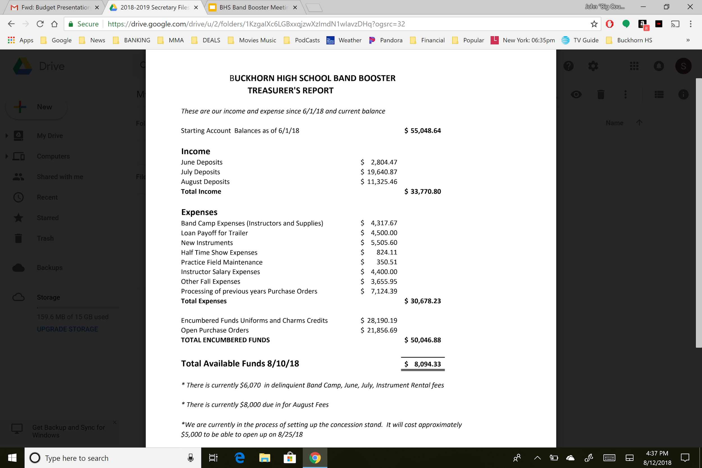

Slide 15
SECRETARY
Committee Chair - Charms/Forms: Kim Grantham
- Communication/Web: Monica Yother
Forms Importance
Ways to Communicate:
#1 - Remind App = Text “@buckho” to 81010
Charms Emails = charmsoffice.com
Website = www.buckhornband.com
Twitter handle = @buckhornHSband
Facebook =Buckhorn HS Band News & Events (Private)
Buckhorn High School Band (Public Forum)
Groups (LOOTS; Percussion; Color Guard etc.)

Slide 16
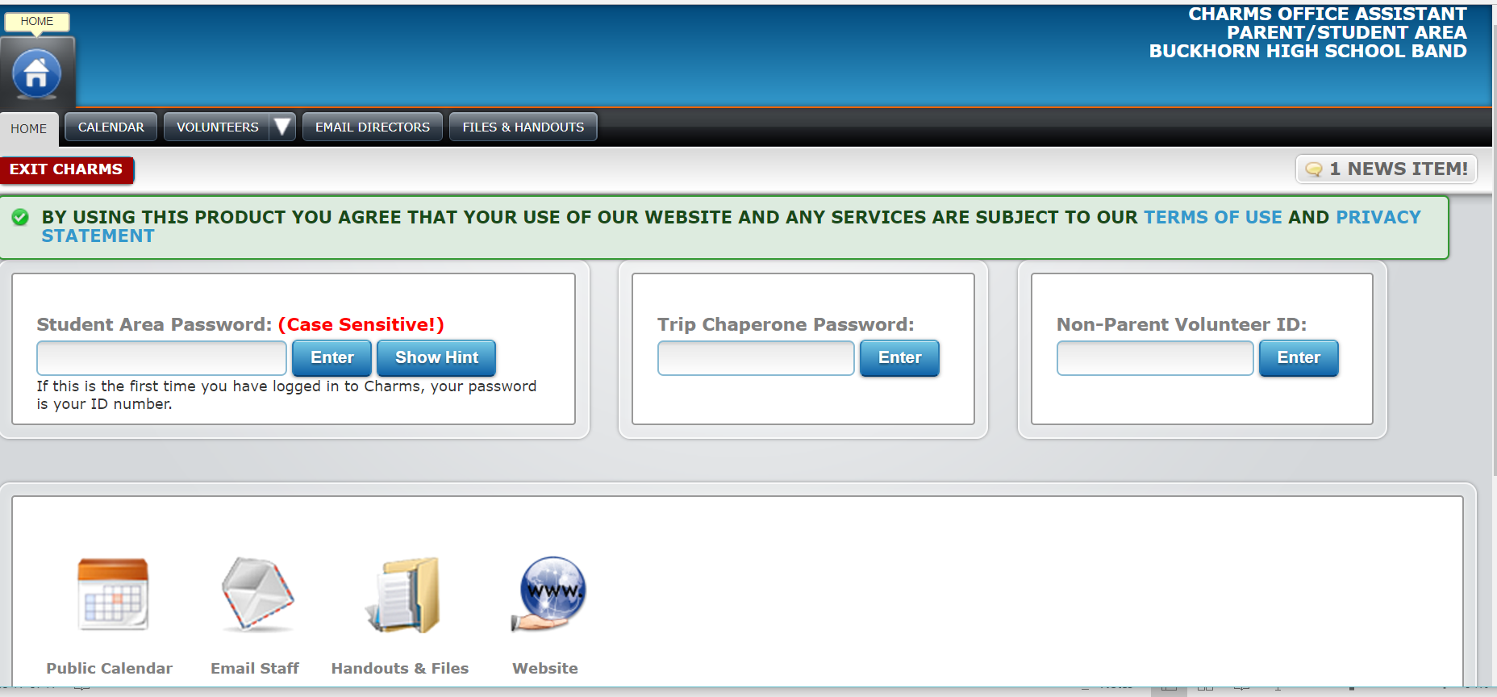
SCHOOL CODE: buckhornband

Slide 17
Show Shirts Status
This year, instead of providing show shirts to the students, Mr. Souder is providing Buckhorn Band shirts. This will give our students a uniform look when they attend events.
What about the show shirts??? Shirts will be available for parents and students to purchase (approx. $13.00) online. This is not a fundraiser but a must-have as a memento & way to show your support of our band! Will make a great shirt to wear on our trip to NYC!
Sneak Peek Ahead…..thanks kids for choosing the shirt color.

Slide 18
Thank you, Monica Yother, for your design vision:
“The clock, for the title Tick Tock - with music as the time.
The city in reference to (first movement - asphalt cocktail) and a nod to the spring trip to NY. The lines are a staff and clock hands and seen as strings (second movement, adagio for strings) and in the background
“Can’t Stop The Feeling” (third movement.)”

Slide 19
New Business/Q&A
Thank you for your participation and support of your Buckhorn High School Band Booster Association. Go Bucks!!!
Enjoy the show…
*TICK TOCK*

